Slide 1
Optimization of Swimming Fin
Jiujiu (Joey) Lou
August 2018
University of Tokyo

Slide 2
Steps Taken
Understand and implement Genetic Algorithm
Understand physical simulation (FEM)
Interpret results from simulation
Perform optimization

Slide 3
Genetic Algorithm, Knapsack
A T
G C

Slide 4
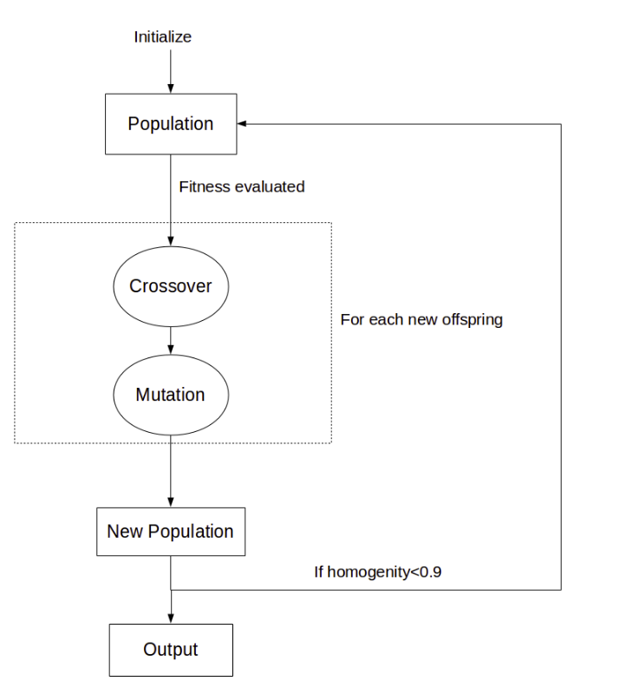
Key Features
Fitness evaluation
Crossover between parents
Mutation
Move from generation to generation

Slide 5
Implementations
Variables
Binary representation of Knapsack problem
Single point crossover
Point-wise mutation
Roulette selection
Crossover probability
Mutation probability
Population size
Generation number

Slide 6
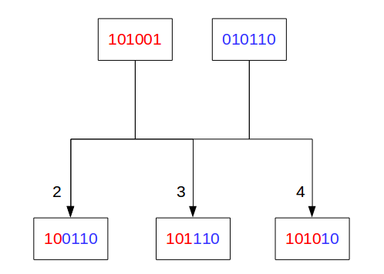
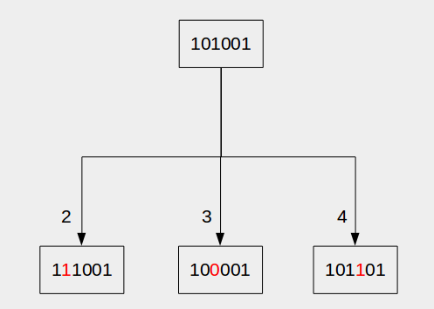
Single-point crossover
Point-wise Mutation

Slide 7
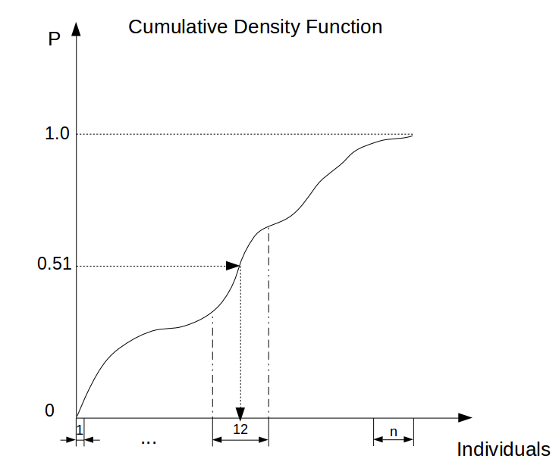
Roulette Selection
Finding a random fraction between 0 and 1, then the corresponding individual on cumulative density function will be selected as one of the parent.
Here, number 0.51 is generated, which corresponds to individual 12 on the curve.

Slide 8
Variables
Results
Higher mutation probability
Higher crossover rate
Larger population size
More generations
Longer to converge, but less likely to stuck in local optimum
More searching between high fitness individuals
Larger search space
More time to converge

Slide 9
Real Coded Genetic Algorithm
Minimize Unimodal function: F=(X₁)²+(X₂)²+(X₃)².

Slide 10
Outline
Selection method:
Roulette
Tournament
Crossover method:
Laplace
BLX-alpha
Arithmetic
Mutation method:
Power
Uniform
3 input variables and many different methods to try

Slide 11
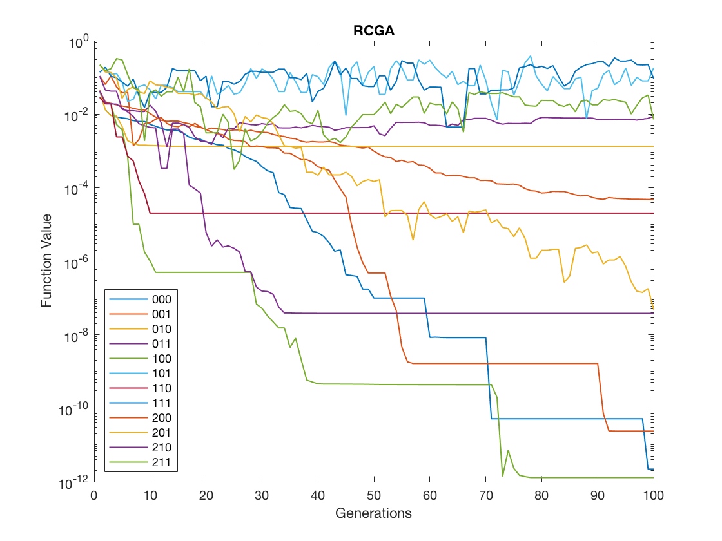
Evaluation
All combinations of methods aforementioned are tested out and ran till generation 100.
Best runs correspond to ‘100/200’, which uses:
BLX-alpha/ Laplace crossover
Uniform mutation
Tournament selection

Slide 12
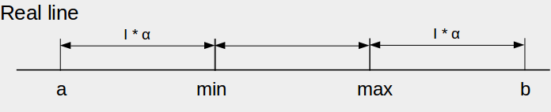
BLX-alpha
Given two parents, P₁, P₂ and determine offspring O₁.
I = | P₁- P₂ |
a = max(P₁, P₂) + I*𝜶
b = min(P₁, P₂) - I*𝜶
O₁ = random (a, b)
Crossover method

Slide 13
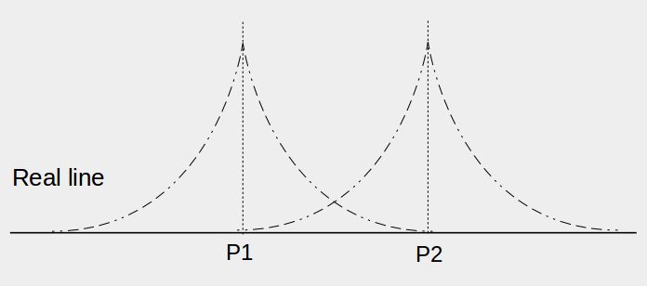
Laplace
Given two parents, P₁, P₂ and determine offsprings O₁, O₂.
𝜶 = random(0,1)
𝜷 = a ± b*log(𝜶)
O₁ = P₁ + 𝜷*| P₁ - P₂ |
O₂ = P₂ + 𝜷*| P₁ - P₂ |
Crossover method

Slide 14
Uniform
r = random(0,1)
Xᵢ = Xᵢ ± delta*r
Equal chance for both signs, delta shrinks as generation moves on and eventually reaches zero.
Mutation method

Slide 15
Tournament
A number of individuals will be selected from whole population to participate in a “tournament”.
The fittest individual from the group will be selected as the parent.
The larger the tournament size, the more discriminative the selection process will be.
Selection method

Slide 16
1D Rod Extension FEM
Referenced chapter 3 in Finite Element Method book.

Slide 17
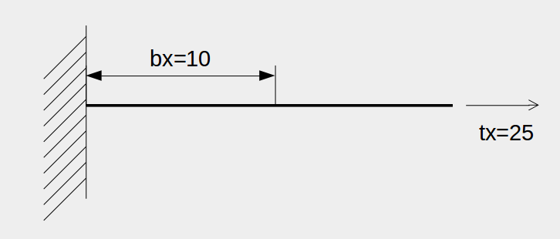
Problem setup
E = 1000
L = 10
bₓ = 10 ( 0 < X < 5 )
tₓ = 25
1-D rod extension

Slide 18
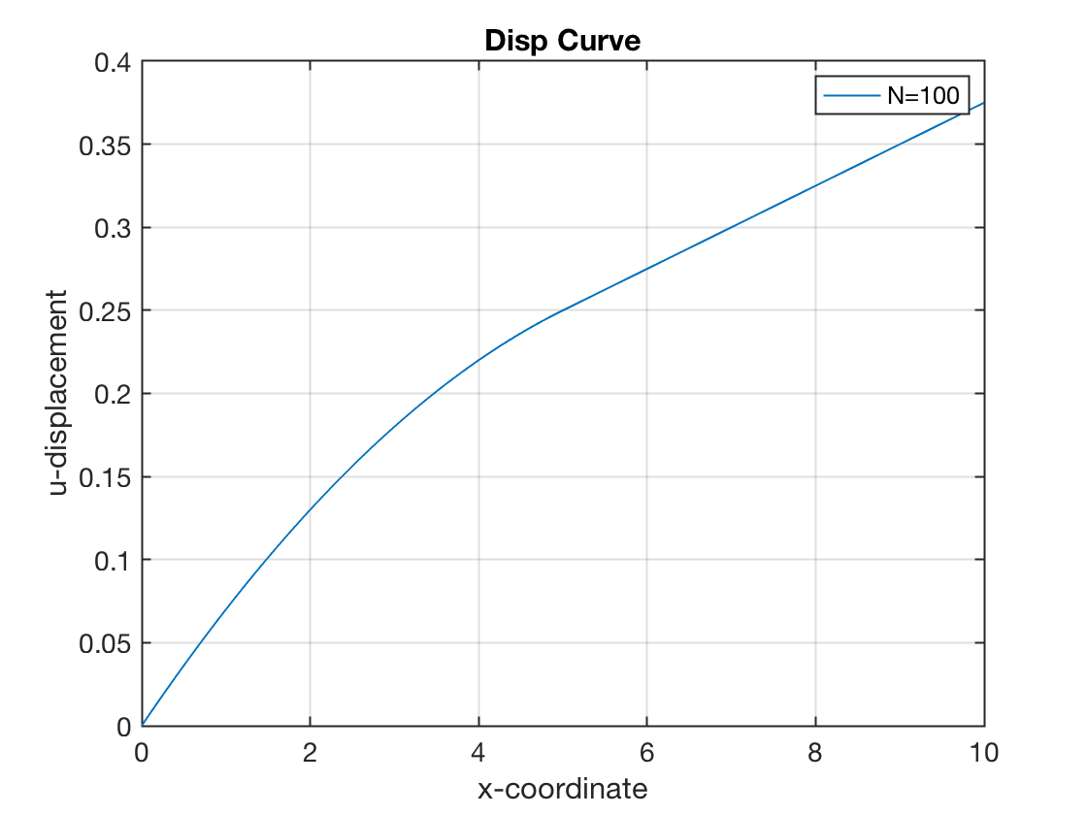
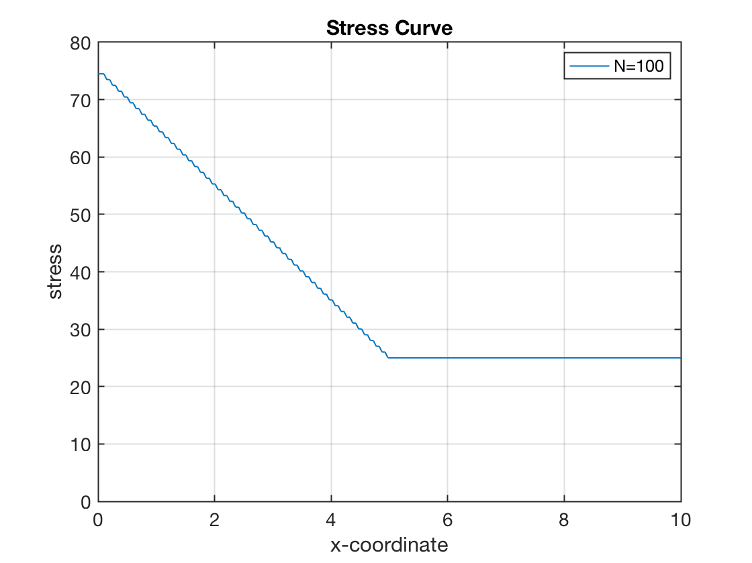
Results
Even with first order shape functions, we can achieve reasonable results.

Slide 19
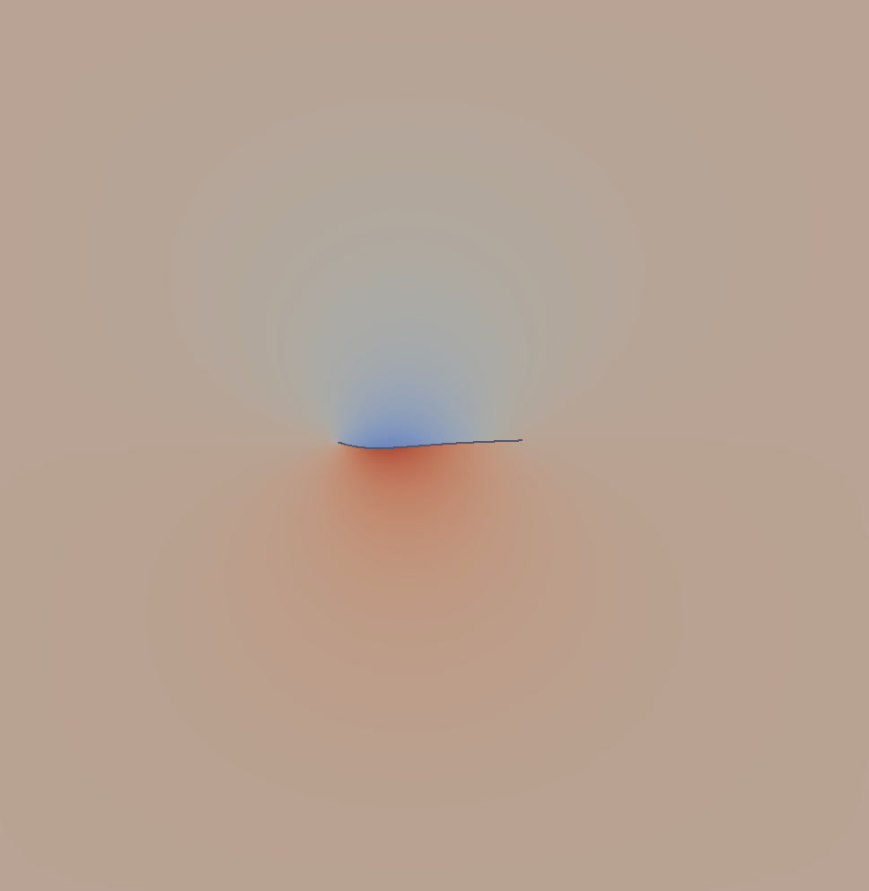
Interpret FSI Data
Evaluate power (energy) and velocity.

Slide 20
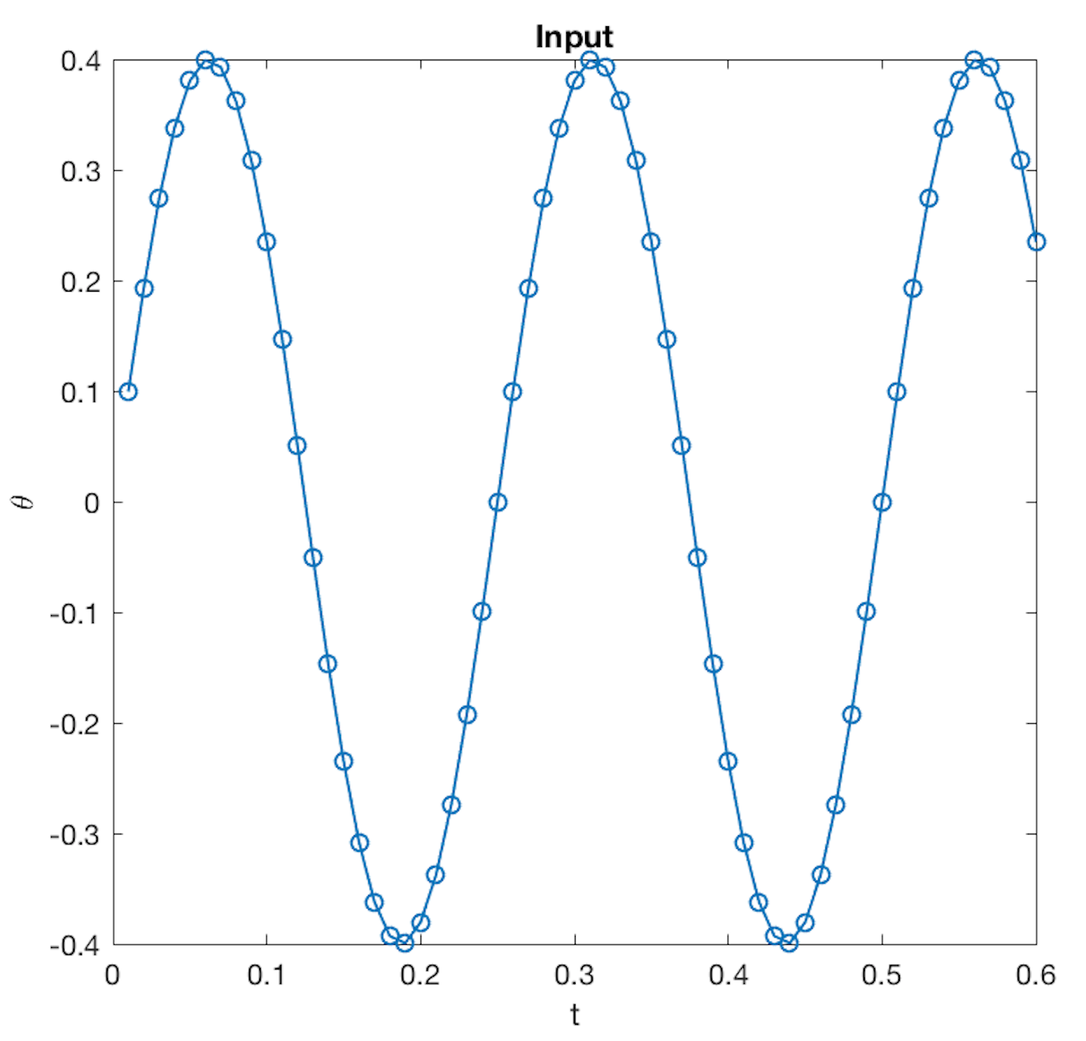
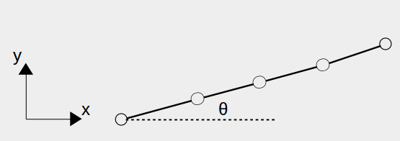
Sinusoidal input
Dirichlet conditions are imposed onto first node of beam, where y position and angle 𝜃 are fixed.
y = 0
𝜃 = α*sin(2𝜋*𝑓*𝛥𝑡*n), where n is iteration number, 𝛥𝑡 is time step.

Slide 21
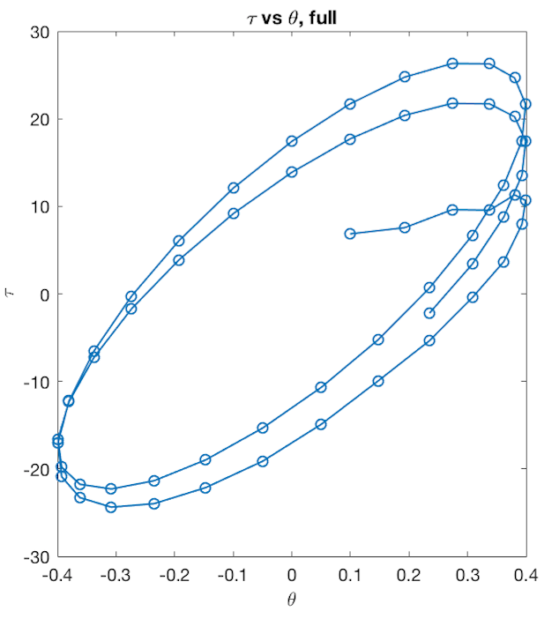
Torque vs theta
Circular patterns can be seen.
The number of circles corresponds to number of input cycles (sine wave).
At startup, the pattern is not stable.

Slide 22
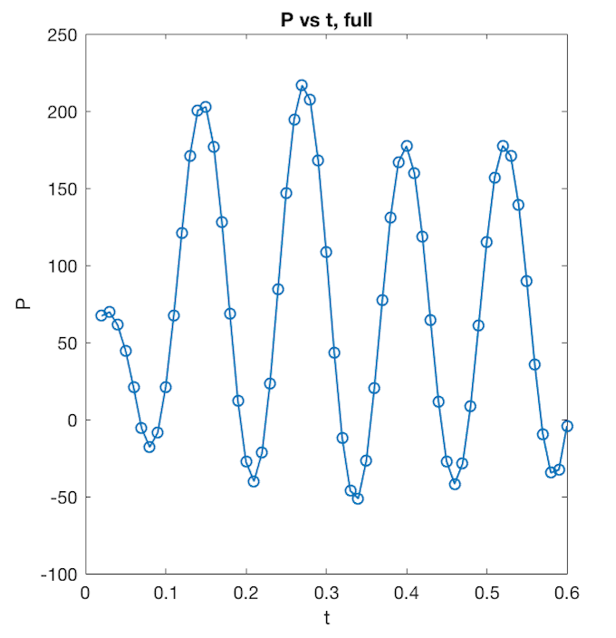
Power input over time
Power at iteration i:
Pᵢ = (𝜽ᵢ - 𝜽ᵢ₋₁)*(𝜏ᵢ + 𝜏ᵢ₋₁)/(2*𝛥𝑡)
Average power:
Pavg = 𝛴 P / (N-1) , where N is max iteration
Negative power is achieved when torque acts in the opposite direction of movement.

Slide 23
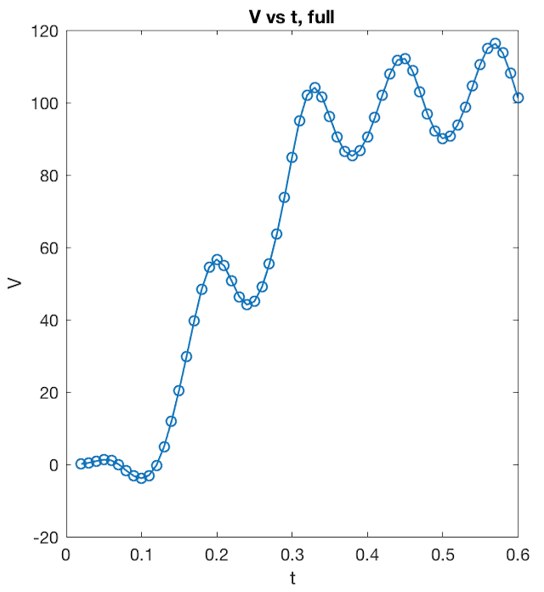
Velocity over time
Velocity at iteration i:
Vᵢ = (𝑥ᵢ - 𝑥ᵢ₋₁)/𝛥𝑡
Average velocity:
Vavg = 𝛴 V / (N-1)

Slide 24
Optimize Fin
Apply RCGA to achieve balance between power and velocity.

Slide 25
Input
Input wave for angle 𝜃:
𝜃 = α*sin(2𝜋*𝑓*𝛥𝑡*n)
We control two variables:
α = Amplitude, 𝑓 = frequency

Slide 26
RCGA
Evaluation function for fitness:
F = V^(2.75)/P
Range for input variables:
α ∈ [0.1, 1], 𝑓 ∈ [2, 10]
Population size: 30.
Generation number: 100.

Slide 27
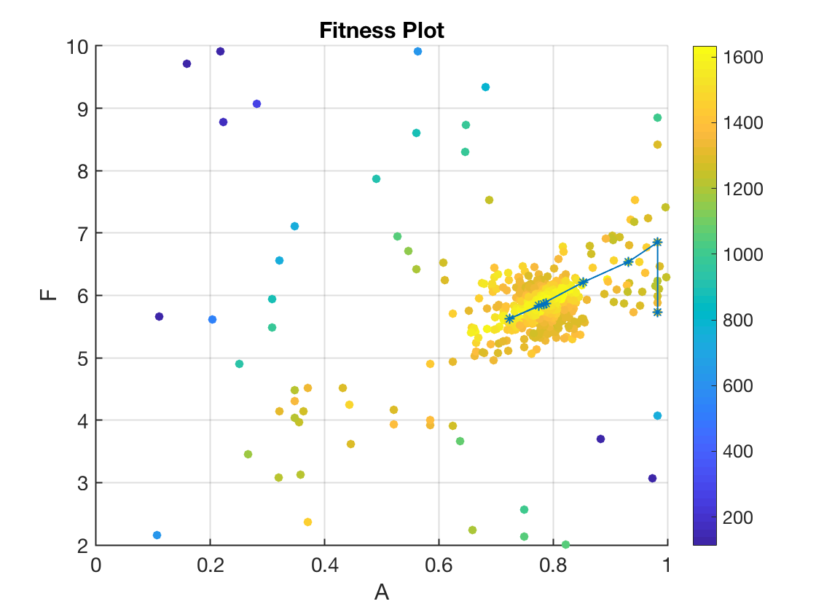
Sample Run
Each point corresponds to a FSI simulation.
Blue line represents the path taken by highest fitness score in each generation.
High fitness trials cluster around light yellow belt section.

Slide 28
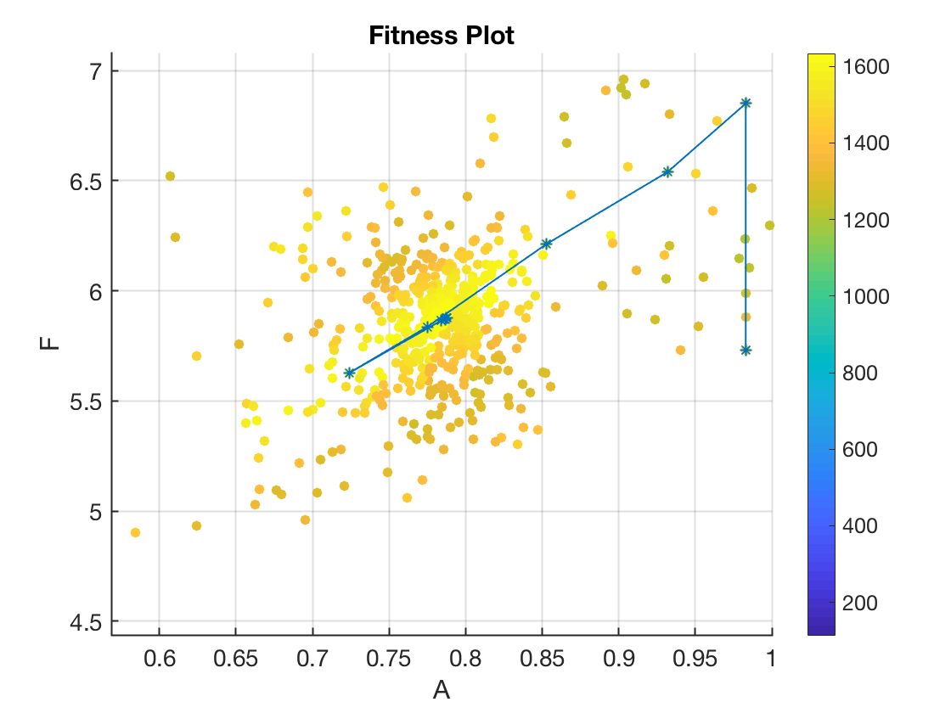
Sample Run
Best individual in final generation:
A=0.787778,
F=5.877350,
FIT=1633.676761.
Fitness score are very close to each other.

Slide 29
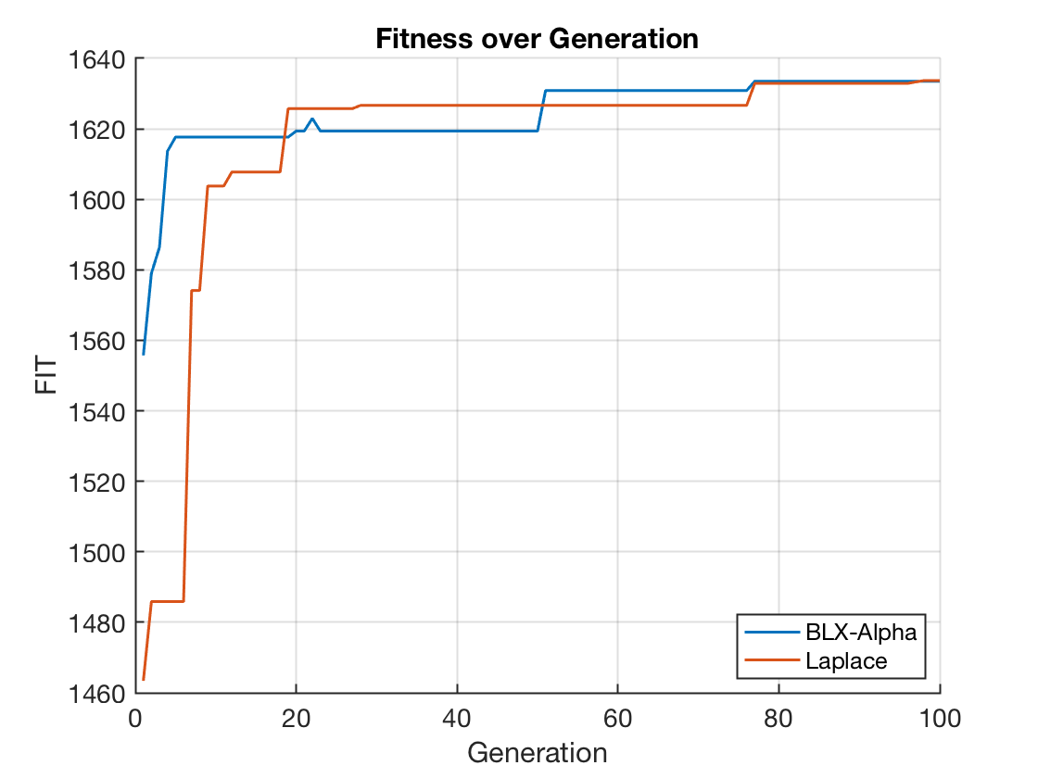
Convergence
Two methods differ only in crossover methods (BLX-alpha and Laplace).
Both converged to:
A=0.787251, F=5.869870, FIT=1633.506547
A=0.787778, F=5.877350, FIT=1633.676761

Slide 30
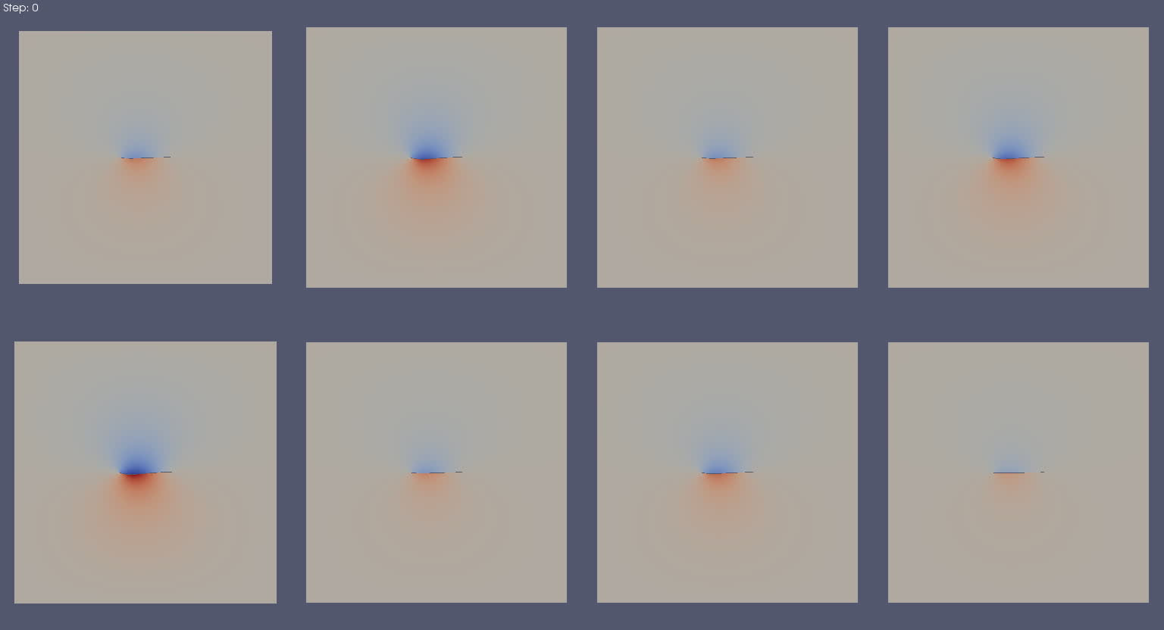
Generation 1

Slide 31

Generation 20 - Solution becomes homogeneous.

Slide 32
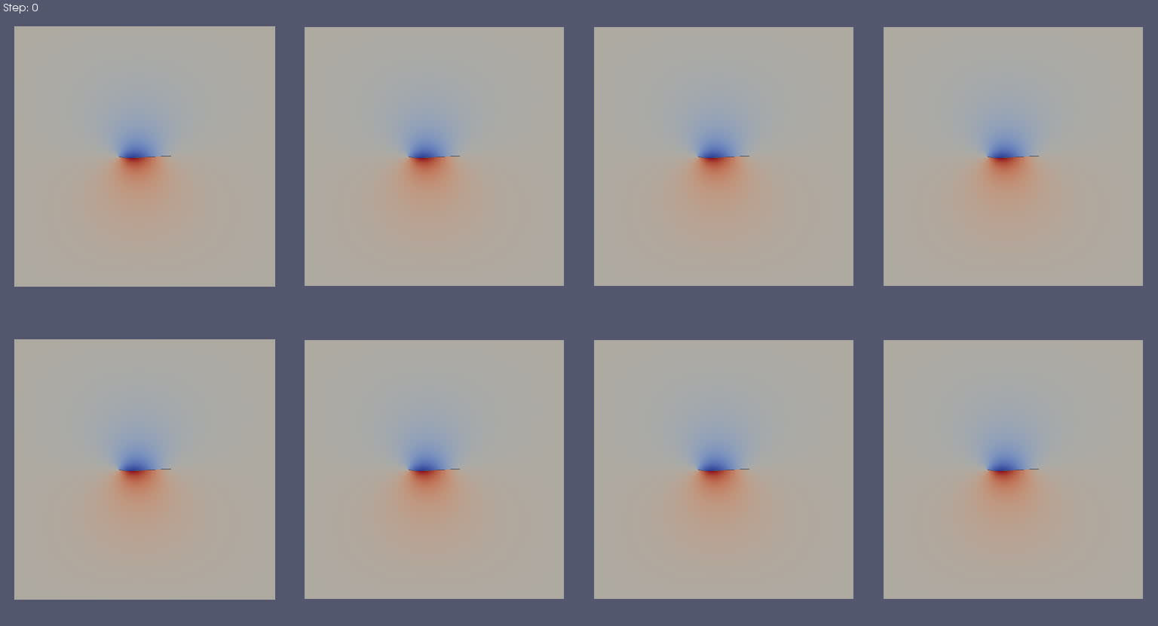
Generation 100
- Global optimum reached.

Slide 33
Further Developments
Optimize existing RCGA.
Expand input space using Fourier series.

Slide 34
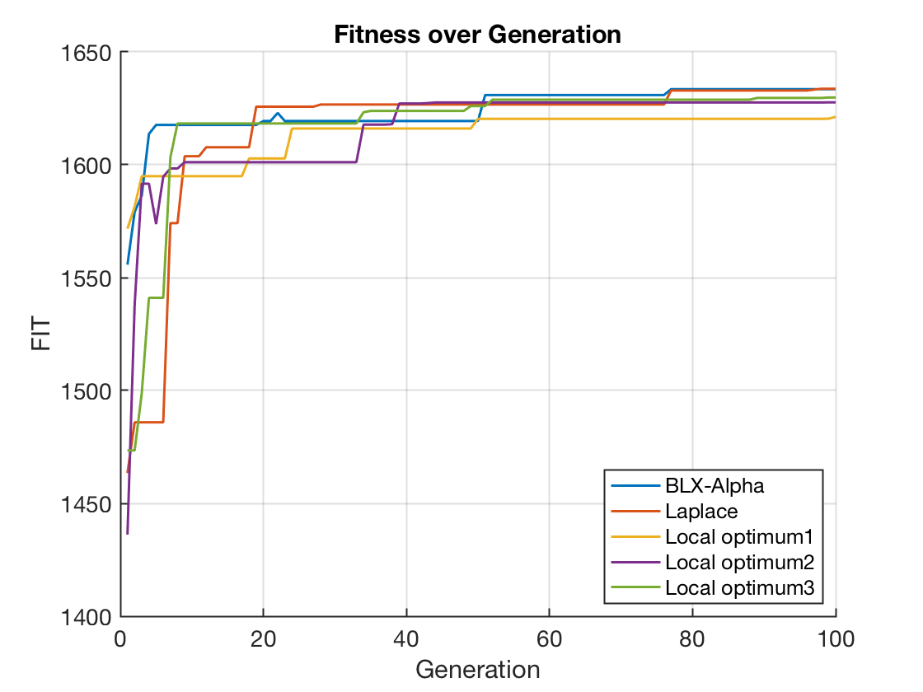
Avoid Local Optimums
Problems:
Multiple local optimums exist.
Reached homogeneity too quickly.
Existence of errors.
Possible Solutions:
Tune GA parameters for faster and better convergence.
Try other methods.
Reformulate the evaluation function.
Enlarge the simulation space.

Slide 35
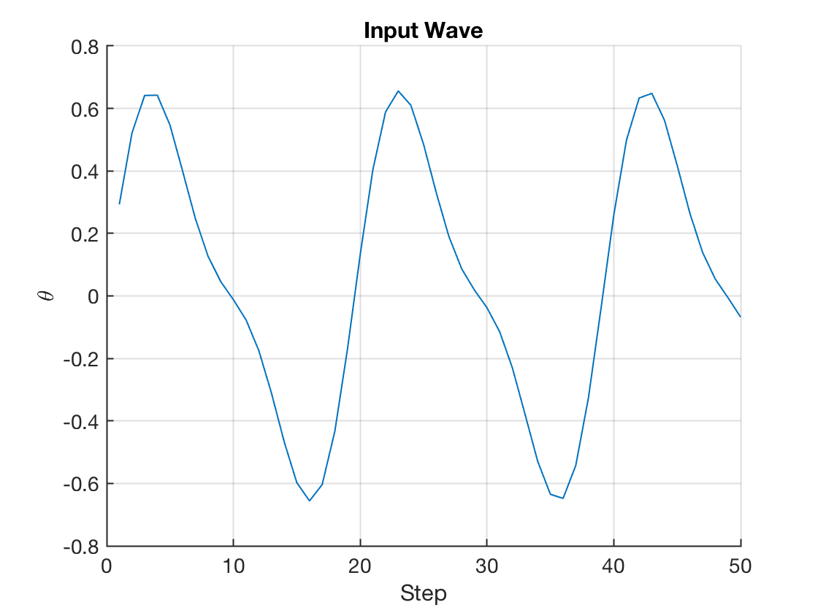
Use Different Inputs
Input in Fourier series:
𝜃 = α₁*sin(2𝜋*𝑓*𝛥𝑡*n)+α₂*sin(2𝜋*2𝑓*𝛥𝑡*n)
Result:
A1=0.560227, A2=0.193823,
F=5.111914, FIT=1595.007598.

Slide 36
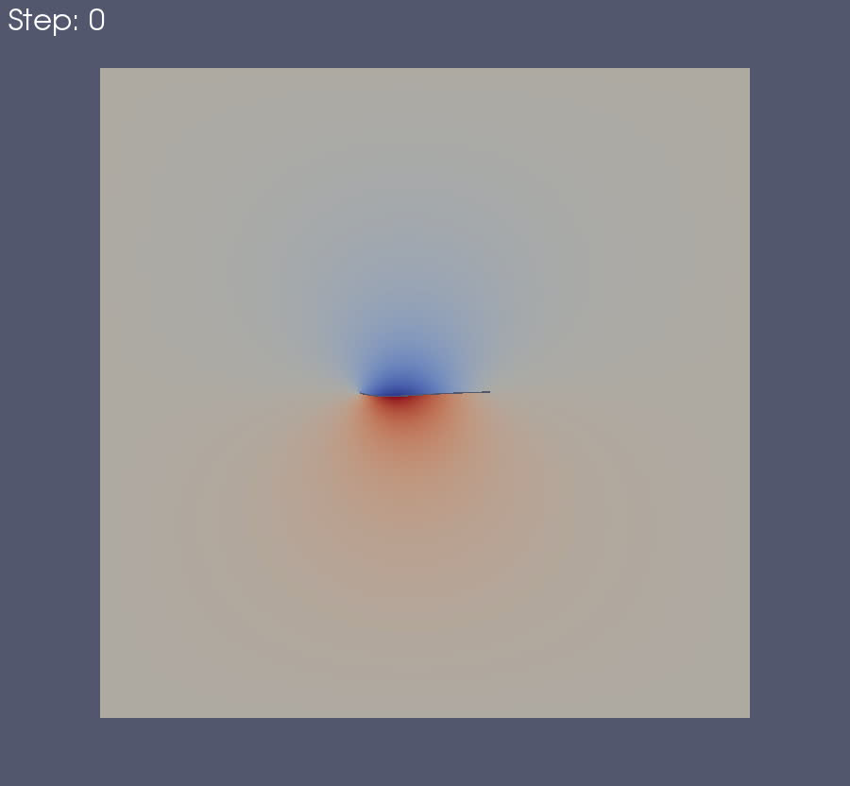
Solution with input from previous slide:

Slide 37
End of Research Presentation
Questions?

